Slide 1
PYTHON PROGRAMMING
PRESENTATION

Slide 2
FUNCTIONS
Python Functions is a block of statements that return the specific task. The idea is to put some commonly or repeatedly done tasks together and make a function so that instead of writing the same code again and again for different inputs, we can do the function calls to reuse code contained in it over and over again.
Some Benefits of Using Functions
Increase Code Readability
Increase Code Reusability

Slide 3
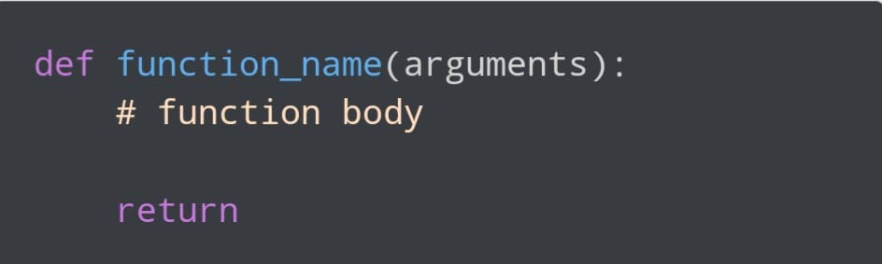
FUNCTION DECLARATION
Types of Functions in Python
There are mainly two types of functions in Python.
Built-in library function: These are Standard functions in Python that are available to use.
User-defined function: We can create our own functions based on our requirements.

Slide 4
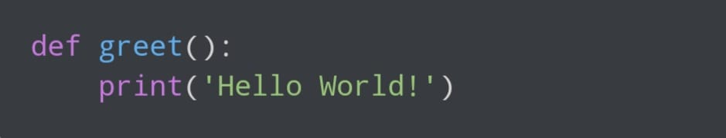
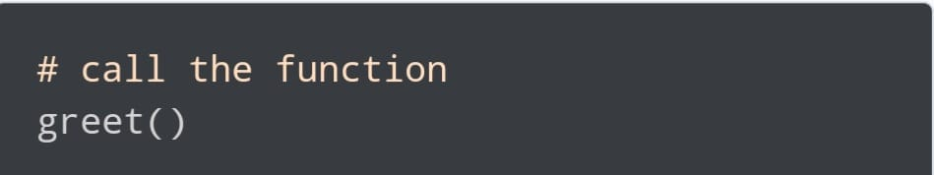
CALLING A PYTHON FUNCTION
In the above example, we have declared a function named greet().
Now, to use this function, we need to call it.
Here's how we can call the greet() function in Python.

Slide 5
MODULES
A module is simply a Python file with a .py extension that can be imported inside another Python program.
The name of the Python file becomes the module name.
The module contains — 1) definitions and implementation of classes 2) variables and 3) functions that can be used inside another program.
Advantages of modules –
Reusability : Working with modules makes the code reusable.
Simplicity: Module focuses on a small proportion of the problem, rather than focusing on the entire problem.
Scoping: A separate namespace is defined by a module that helps to avoid collisions between identifiers.

Slide 6
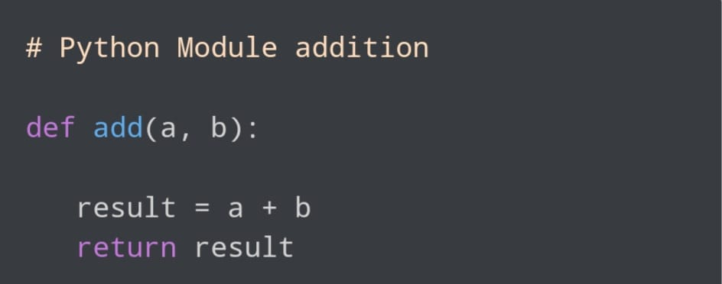
CREATING A MODULE
1
To create a function — A function is defined using the def keyword
Here, we have defined a function add() inside a module named example. The function takes in two numbers and returns their sum.

Slide 7
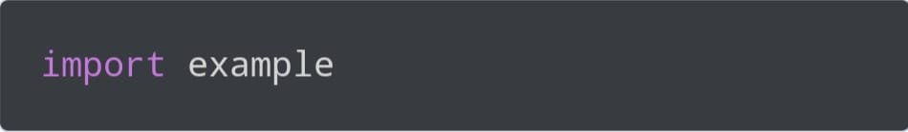
IMPORT IN MODULES
We can import the definitions inside a module to another module or the interactive interpreter in Python.We use the import keyword to do this. To import our previously defined module example, we type the following in the Python prompt.
This does not import the names of the functions defined in example directly in the current symbol table. It only imports the module name example there.

Slide 8
DATA MANIPULATION
Data manipulation with python is defined as a process in the python programming language that enables users in data organization in order to make reading or interpreting the insights from the data more structured and comprises of having better design. For example, arranging the employee’s names in alphabetical order will enable quicker searching of a particular employee by their name. The key feature of data manipulation is enabling faster business operations and also emphasize optimization in the process. Through proper manipulated data one can analyze trends, interpret insights from financial data, analyze consumer behaviour or pattern, etc. Not only the analyzing, but it also enables users to neglect any unnecessary data in the set so that one can save space and only fill the limited space with important and necessary data.

Slide 9
DATA MANIPULATION METHODS
Python has been the most famous and most used language amongst developers in order to manipulate data in a dataset. With open-source implementations in Python, we have various methods that help in the implementation of the manipulation methods in Python. For all the following methods we would first need to install pandas in python and that can be achieved by running the following command in the command prompt:
pip install pandas
Once the pandas package is installed in the system, we would need to import the pandas library into our codebase by running:

Slide 10
DATA MANIPULATION METHODS
import pandas as pd
The reason one would use pd is to make sure that we can use the short form wherever we would need to call the corresponding package. Now that we have installed and imported the pandas library, we would use one of its functions to read the CSV file and then store the return dataset into a variable. we would run the following code:
variable_name = pd.read_csv("file name.csv")

Slide 11
THANK YOU

